Slide 1
Healthy Children
Notes:
HEALTHY CHILDREN OUTLINE
Health screening and catch-up immunisation for refugee background families
Healthy Eating
Low vitamin D
Oral Health
Safe sleeping
Development
Services for kids and families (MCHC, Playgroup, Kinder)

Slide 2
Health checks
Notes:
All kids and adults of refugee/asylum seeker background should have a health check at a doctor after arriving in Australia
Ideally soon after arrival
But if you have been here a while, but not had this – still worthwhile doing

Slide 3
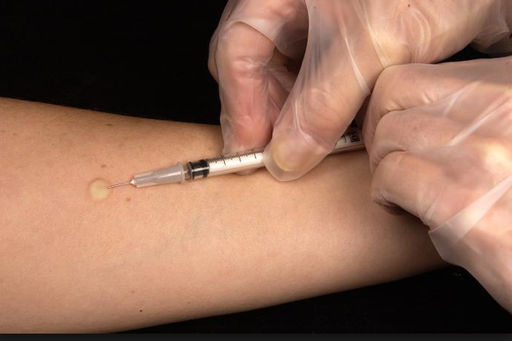
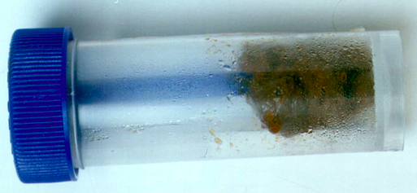
Health checks
Notes:
Refugee health screening involves:
Blood test
Skin test – to see the person has been in contact with the TB (Tuberculosis) germ (this test does not say whether they are sick with TB)
Poo test – especially if diarrhoea or tummy pain

Slide 4
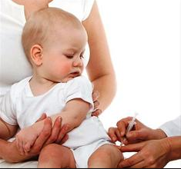
Immunisation
Notes:
Immunisation is important
Started early – for babies and young children
Safe and experienced providers
Everyone of refugee/asylum seeker background will need catch-up immunisation (all ages)

Slide 5
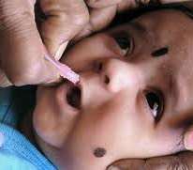
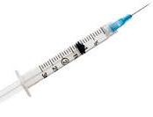
Immunisation
2, 4, 6 mths
12 mths
18mo
3 ½ - 4 years
Notes:
Immunisation for babies
Safe, simple and effective against serious and life threatening illnesses
Assume under immunised and catch-up immunisation is advised
At birth (if born in Australia): 1 needle
At 2,4,6 months: 2 needles and 1 oral vaccine
At 12 mths: 2 needles
At 18 mths: 1 needle
At 4 years: 1 needle (can be given from 3.5yrs)

Slide 6
Immunisation catch-up
Visit 1
Visit 2
Visit 3
Notes:
Catch-up immunisation for older children and adults
Needed for anyone without immunisation paperwork
Usually 3 visits over 4 months
Up to 4 needles a visit
Often less needles
Important

Slide 7
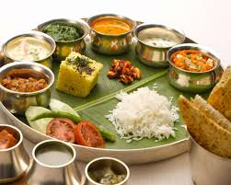
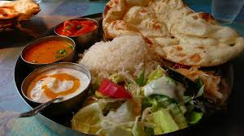
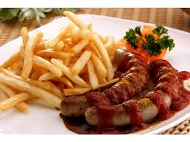
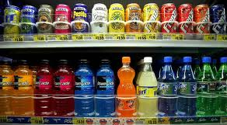
Healthy eating
Notes:
Traditional foods with lots grains, vegetables – healthier
Easy to eat unhealthy foods and put on too much weight in Australia!

Slide 8
Water is safe
Notes:
Tap water is safe, healthy and free
Should be the main drink for children
Avoid sugary soft drinks, fruit juices, sports drinks, energy drinks and flavoured milk
Boil water for children under 1yr of age

Slide 9
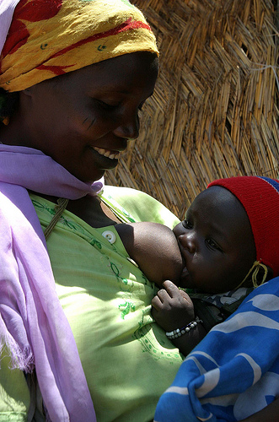
Breastfeeding
Notes:
Breastmilk is the best food for babies
Ideally, Breastmilk only for babies until 6 months, And still is the best milk for up to 12 mths
Breast milk is free, convenient, good for baby, environmentally friendly and lovely
How long you breastfeed is entirely up to you and your baby
Babies should start some solid food by 6 months, and should be on 3 solids meals a day by 12 months

Slide 10
Healthy eating
Notes:
Need to eat different types of foods – not all rice, or all milk
Protein for building strong healthy bodies – meat, fish, soy, eggs (some)
Vegetables/Fruit for nutrients and fibre (lots)
Carbohydrates for energy – lentils, rice, grains (lots)
Good fats for building brain and nerve cells (a little)

Slide 11
Healthy eating
Notes:
Important to set up healthy eating patterns from the beginning
Picture 1-3:
Buy enough food for school lunches and snacks
Allow your child to help choose from healthy options for their lunch box from the main food groups
Picture 4-6:
Different coloured foods have different nutrients so pack your child a ”rainbow” of fresh foods to obtain a diverse range of nutrients
“Nude” packaging means no plastic/disposable wrapping! Use re-useable plastic containers/pockets/wraps to save money and the environment.
Tap water is the best drink for your child.
Drink plenty of water.

Slide 12
Healthy eating
Notes:
Ideas for healthy eating!!! (below is descriptions of food if needed)
Breakfast: Banana porridge- oats, milk, banana, sultanas
Eggs- soft boiled egg with toast
Smoothie- banana/berries/peach with milk and yoghurt
Lunch:
Sandwiches- wholemeal/multigrain bread with meat/cheese/egg
Wrap “n” roll- flat bread with grated cheese and carrot with hummus or avocado
Last night’s home made pizza
Dinner:
Chicken with peas,broccoli, and corn
Beans on Toast with vegetables
Chops with sweet potato mash and salad vegetables
Finger foods:
Bite sized fruit pieces; diced vegetables and vegetable sticks for dipping into hummus
Leave skin on vegetables for extra goodness

Slide 13
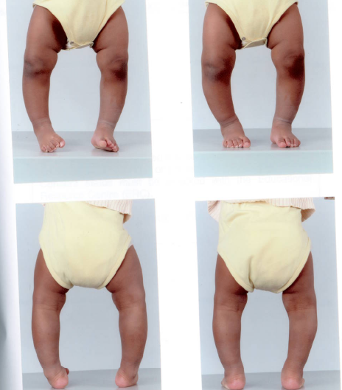
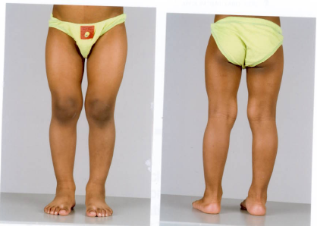
Vitamin D - Rickets
Notes:
Vitamin D is important for healthy bones
Low vitamin D can cause rickets – bending legs because the bones are soft
Rickets is mostly caused by low vitamin D. It can get better with treatment (these pictures are the same child)

Slide 14
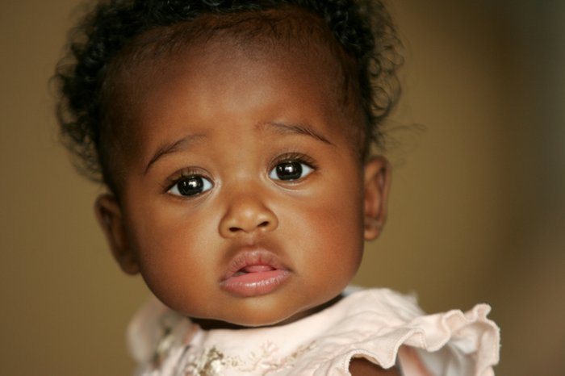
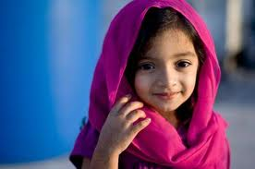
Vitamin D - risk groups
Notes:
Risk groups for low vitamin D:
No or limited sun exposure
Naturally dark skin
Babies born to women with low Vit D

Slide 15
Vitamin D – what to do
Notes:
Prevention and management of low vitamin D
Active outside play (follow sun-smart if light skinned, very dark skin – OK without sunscreen)
Enough dairy – 2-3 serves a day
Kids with risk factors should see a doctor and get their levels checked

Slide 16
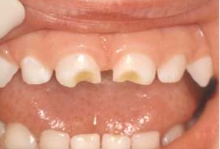
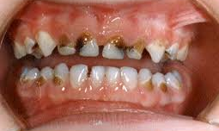
Oral health
Notes:
Caries – ranging from mild to severe
Important problem
Important to prevent

Slide 17
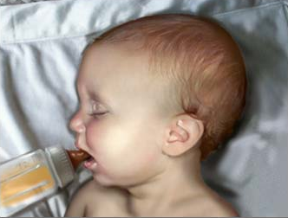
Oral health – risk factors
Notes:
Don’t put baby down to bed/sleep drinking a bottle
Avoid sugary drinks – fizzy, cordial, juice

Slide 18
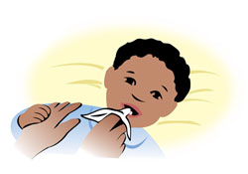
Oral health
Notes:
Basics of oral health information
Picture 1: Wipe teeth with a wet cloth as soon as they emerge twice a day
Picture 2: Use a pea sized amount of low fluoride toothpaste and brush twice a day
Picture 3: Supervise brushing until 8 yrs
Picture 4: Support the chin and check the mouth regularly
Picture 5: Brush in a small circular motion
Picture 6: Rinse well with water
Picture 7: Avoid sugary drinks (tap water best) and high sugary foods and do not let your baby fall asleep drinking a bottle. Eat lots of health foods.

Slide 19
Safe Sleeping
Notes:
Do’s and Don’ts
Pictures 1-3:
Position baby “back” to sleep (and not on the tummy or side-lying)
Pictures 4-5:
Sleep baby at the bottom of the cot so they cannot slip under the covers, with nothing else in the cot except baby and blankets
No pillow, doona, teddies or cot bumpers in the cot as provide additional risks

Slide 20
Safe Sleeping
Notes:
Safe sleeping (SIDS advice)
Put baby on their back to sleep - Wrapping helps baby to stay on their back
Don’t overdress baby, the head should not be covered
No Smoking: Quit or do not smoke in the house

Slide 21
Co-sleeping
Notes:
Co-sleeping can be safe, but need to use same safe sleeping advice
Many cultures co-sleep with their babies/children and many believe it makes the baby feel safe and secure
It is safe as long as you follow the safe sleeping tips (“back” to sleep; no pillow; no covering of head; smoke free environment)
Co-sleeping is dangerous if you or your partner smoke or take drugs (including alcohol or sedative medication)

Slide 22
Development - talking
1 y
Notes:
Normally expect
1st words at 1
2 words together at 2
Sentences at 3
Encourage 1st language
If you are worried about your child’s talking – ask MCHN or doctor

Slide 23
Notes:
Continue your first language!
This is the most important thing to help your child learn a new language. They need to keep thinking and learning in their mother tongue, to learn well, and its also important for families and culture.
OK to look at pictures and tell a story, it doesn't matter if you can’t read the language
It takes years (for kids and adults) to learn to think in a new language

Slide 24
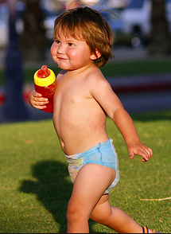
Development - movement
1 y
2 y
3 y
Notes:
Normally expect
1st steps at 1yr
Running well at 2yrs
Balance one leg at 3yrs
If you are worried about your child’s movement – ask MCHN or doctor

Slide 25
Development - Play
Notes:
Baby signs of development (eye contact, turning head towards you, engaging with play)
Talk, sing, read and play with babies too!

Slide 26
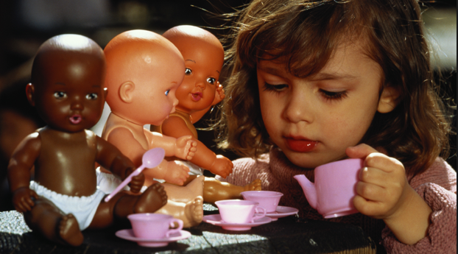
Development - Play
Notes:
Play is important at all ages
By 3 years – pretend play and play with other children
If you are worried about your child’s play, or being scared of other children – ask your MCHN or Doctor

Slide 27
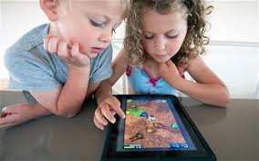
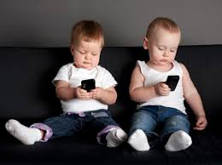
Development
Notes:
Limit screen time (TV, mobile, computer screen, DVD)
< 2yrs- no screen time
2-5yrs- less 1 hr per day
> 5yrs- less than 2 hrs per day

Slide 28
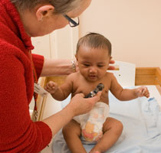
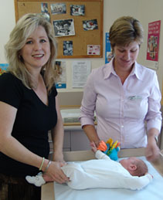
Maternal and Child Health Centre
Notes:
MCHC - Free service
Supports child’s health and development from birth to school
Supports family in parenting
Consultations with MCHN at:
2,4,8 wks;
4, 8,12,18 mths;
2, 3 ½ yrs
Contact local council for nearest MCHC
24 hour MCHN Line Tel.132229

Slide 29
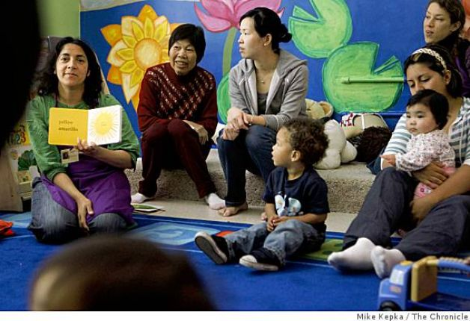
Play group
Notes:
Playgroups/parent groups provide support, friendship, information and play mates

Slide 30
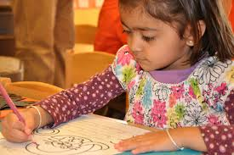
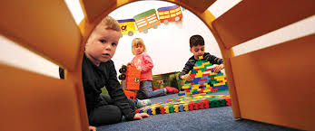
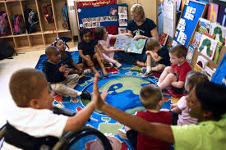
Kinder
Notes:
Kinder is important, and helps kids to get ready for school in Australia. All kids should go to kinder
3 year old kinder: 2-4 hours per week as per Kindergarten
4 year old kinder: 15 hours government funded
Fee subsidy to Refugee/Asylum seeker/Humanitarian visa holders so no or minimal cost only
Children learn to play, build and create, interact, connect with other’s and their environment, communication skills, responsibilities, sharing and telling stories
Kinder enrolment needs to be supported at time of settlement – ask your Case Worker

Slide 31
Notes:
You have a right to an interpreter!

